Slide 1


Interoperability Engineer @ Challenge Presentation
UpHill Health
Nuno Miguel Braz Pimenta
September 2023

Slide 2
OBJECTIVES
Develop a HL7 FHIR R4 RESTful service;
Solution must follow a certain group of pre-defined requisites;
Challenge completion and its discussion aim at accessing the candidate’s set of skills.
2

Slide 3
PROJECT’s DELINEATION CONSIDERATIONS
Follow challenge’s requisites;
Utilize standards and tools normally used in interoperability projects + known to be utilized in UpHill;
Always follow the FHIR specification guidelines;
Build service with few restrictions to future upgrades – scalability concerns;
Utilize FHIR server w/ messaging and w/ FHIR RESTful interactions + HAPI FHIR capabilities– path better known and better suited.
3

Slide 4
Receiving message (req. 1)
$process-message operation (FHIR specification) “operation accepts a message, processes it according to the definition of the event in the message header, and returns one or more response messages;
Synchronous + reliable messaging;
Aspects to validate/consider:
“it’s not an idempotent operation” (need caution on this);
“only accepts POST transactions - other HTTP methods will result in an HTTP error”;
request content type submitted is always Bundle with type "message" containing a MessageHeader resource as the first resource.
4

Slide 5
Receiving message (req. 1)
Considerations/assumptions:
Receiving + responding (requested action’s handling is not part of the service);
“service contract” (FHIR Services paradigm) is based on the pre-defined requisites;
Fields mentioned in the requisites were considered mandatory to be present in a request message;
Only synchronous requests are accepted (assynchronous messaging not implemented).
5

Slide 6
STORAGE – FHIR SPECIFICATION (req. 4)
Relational, or not?
- resources are designed for exchange (rather than as a storage format) - not designed to prioritize storage efficiency;
-BUT “If application's requirements are not at all completely settled, then resources are actually a very sound way to store an application's data”
MongoDB
“A wide variety of technologies exist for storing resources natively, including:
➔NoSQL servers (e.g. MongoDB , Couch , Hadoop , or Big Query )”
“Applications can use the resources defined by FHIR by storing them natively in a database or persistent store”
6

Slide 7
REST REQUESTS + STORAGE– DECISION (req. 2+4)
Why use HAPI FHIR and build a FHIR server?
“the simplest way to handle messages where there are also RESTful interactions occurring is to use the $process-message " (FHIR messaging);
also considering a possible upgrade of the service, for instance, adding more REST interactions;
information is saved in the database (and so made available for other services accessing it);
It is assumed that the ID provided in the GET request belongs to the intended ID systems.
7

Slide 8
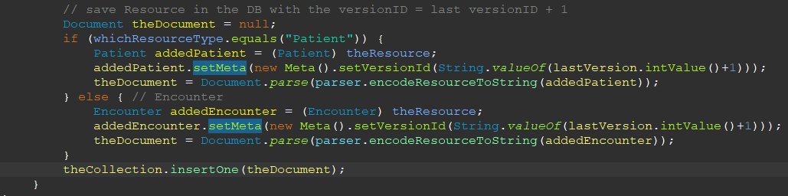
Versioned Resources (req. 5a)
Service supports versioned Resources – knows how to fetch and save Resources with the same ID and different versions in the database;
So, it implements the vread interaction - GET [base]/[type]/[id]/_history/[vid]
Processing verifies if messages or GET requests refer a specific resource’s version, having also the caution of saving information in the database with different version ID (a serially incrementing the such id).
8

Slide 9
Access control - authorization token (req. 5b)
Authorization- ServerInterceptor
Spring Authorization Server
An interceptor is a class that interrupts HAPI FHIR request’s processing chain and has its action at that stage;
@Hook(Pointcut.SERVER_INCOMING_REQUEST_POST_PROCESSED);
Acts before the server analysis on the request, by taking the AuthorizationHeader and validating it at the introspection endpoint of the authorization server.
framework that delivers an implementation of OAuth 2.1 for Authorization Servers;
replaces Spring Security OAuth’s prior Authorization Server support;
central piece concerning authorization and authentication, complementing the FHIR server in that sense;
9

Slide 10
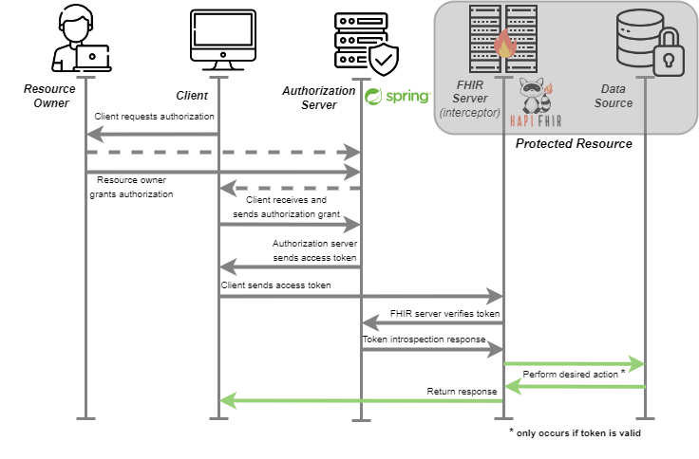
OAuth’s security flow (req. 5b)
10

Slide 11
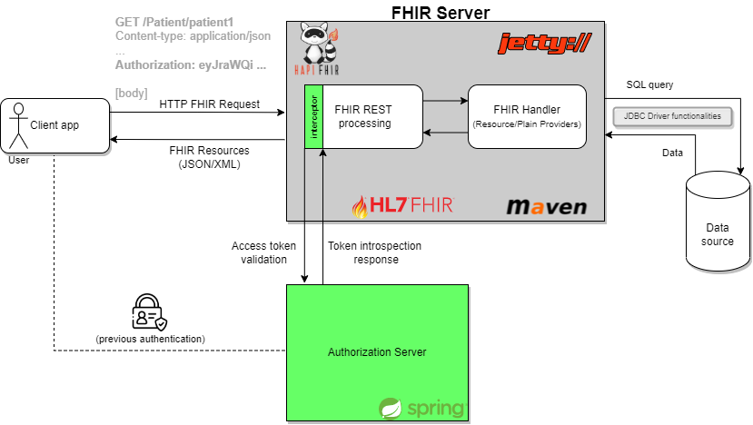
General architecture
Why two different entities?
Modular approach – one entity, one function;
Scalability pourposes;
Ease of modification without affecting the other module.
11

Slide 12
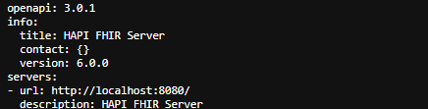
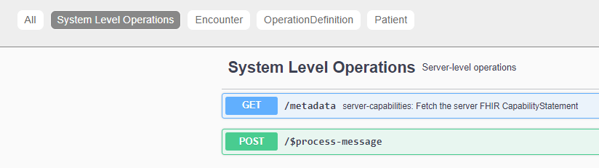
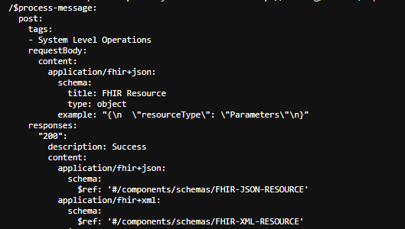
OpenAPI specification (req. 3)
“The OpenAPI Specification is a specification language for HTTP APIs that provides a standardized means to define your API to others. You can quickly discover how an API works, configure infrastructure, generate client code, and create test cases for your APIs”;
“An OpenAPi definition should have: basic REST API information, describe API requests, describe API responses and response examples”;
<dependency> hapi-fhir-server-openapi + OpenApiInterceptor → /api-docs, /swagger-ui;
12

Slide 13
OpenAPI specification (req. 3)
Documentation part was fulfilled;
Testing part not so much …
the fact that browsers do not allow a manual adding of an authorization header, the requests made from the Swagger UI return all an error;
I have become acquainted with tools that may be helpful in doing so: MobHeader and Requestly (both browser’s extensions)
13

Slide 14
Docker Compose file for local service initialization (req. 5c)
Insufficient skills handling Docker Compose hindered its creation;
Nevertheless, it does not represent a service’s component;
the ease that the file would bring for local service initialization is recognized.
14

Slide 15
FILES EXPLANATION
AuthorizationServerInterceptor
encounterProvider
patientProvider
Handles authorization token validation
Deals with Rest interactions - Encounter
Deals with Rest interactions - Patient
messageProvider
MongoDBConnection
Manager
restfulServer
Receives and responds to FHIR messages
Class that manages MongoDB’s database accces
Where classes are registered as part of a restful server
15

Slide 16
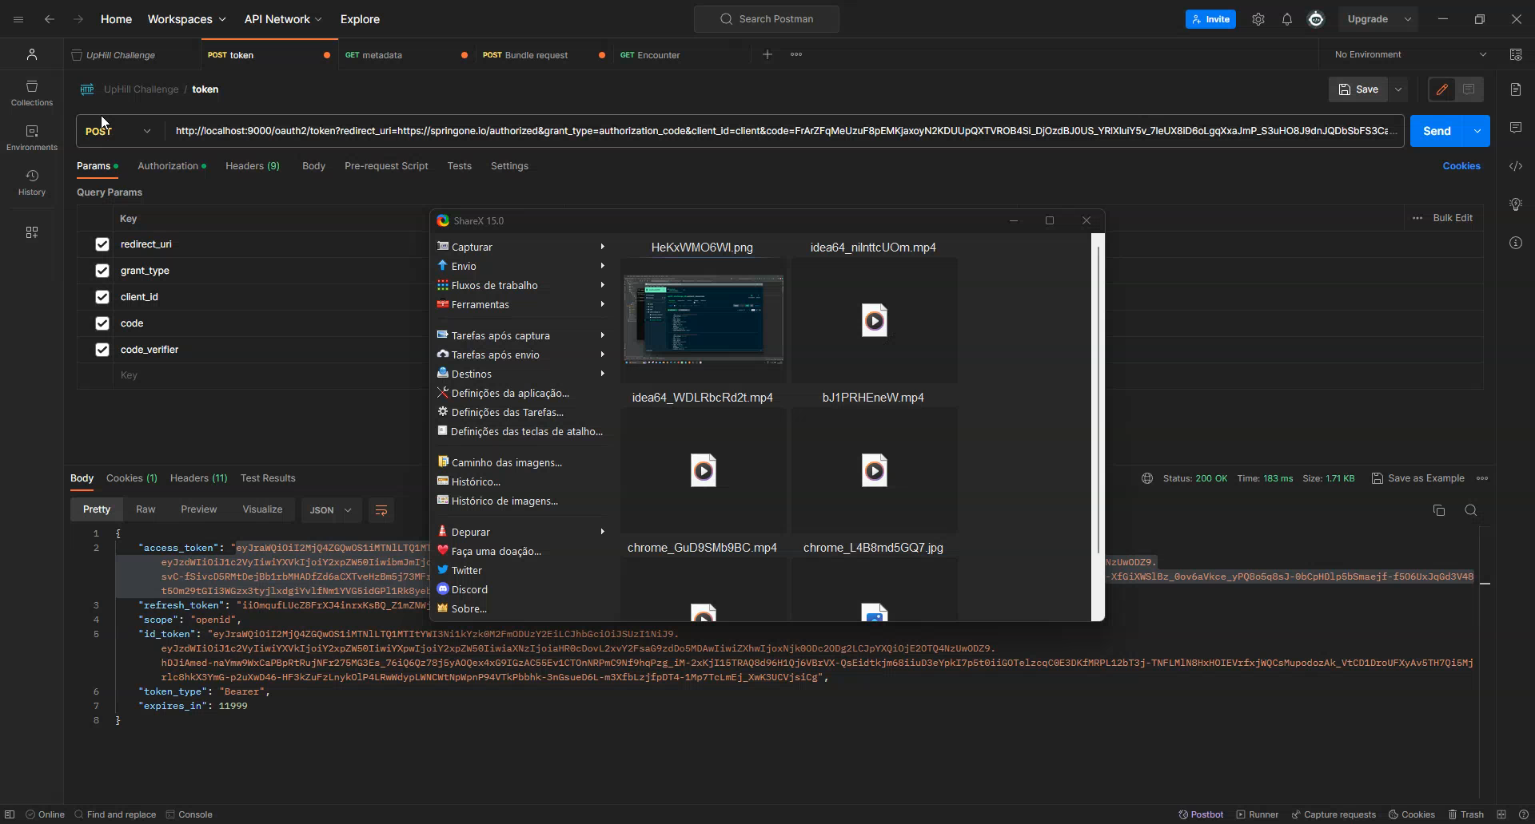
/demo
16

Slide 17
FUTURE WORK
I. Add capabilities to handle messages asynchronously;
II. Develop a service to handle actions requested in the messages;
III. Implement more FHIR restful interactions to manage Resources;
IV. Upgrade authorization mechanism to make it more automated (with less need for user intervention) + add read/write/message permissions to users.
V. Define a properties file so that some variables may not be hardcoded – database definitions, for instance.
17

Slide 18
COMMENTS ON THE PROJECT
It represented a way to dive deeper in a serious and realistic scenario;
It tested my ability for learning new tools and methodologies to achieve intended objectives;
Learned many new aspects on: API design using Spring Boot and its potential, different FHIR paradigms analysis, OpenAPI perception, versioned Resources, Git, thinking about the questions, etc..;
Initial apprehension due to the fact that I thought there may be a lack of knowledge, which was quickly covered with research and learning;
18

Slide 19
COMMENTS ON THE PROJECT
Project’s dedication hours = ~ 35 hours (including debugging, testing, and problems encounter along the way);
It made me think and question myself about software/solution implementation questions that I had not have faced until now;
Job’s requisities were perceived to be based on 3 main aspects:
Healthcare (technology) knowledge;
Healthcare interoperability knowledge;
Software (Java) development expertise (SOLVABLE!).
19

Slide 20
CONCLUSION
Challenge was completed and its requirements were fulfilled;
if one considers the service’s requirements as the ground skills for candidate acceptance, I believe I managed to meet the fundamental criteria and, nonetheless, hope to have had the ability to reach expectations placed;
as far as I know, I just ended up “failing” the OpenAPI web interface testing and the docker compose file submission (despite not being involved directly in the operation of the service);
I should note that I exceeded my own expectations for the development of the project, so I am happy with myself.

Slide 21
ANSWERING THE QUESTIONS

Slide 22
Q1: How would this service interact with a FHIR Terminology Server?
A FHIR terminology server is essential for mapping and translating (medical) codes and concepts, ensuring interoperability between different healthcare systems. Interacting with it involves querying and retrieving healthcare-related terminology and code systems, value sets, and other metadata;
Usual teps for interaction → 1) find useful URL endpoint, 2) authentication (if needed), 3) query data (example: GET /CodeSystem?url=http://example.com/codesystems/123)
valueset expansion: restrict codes in a valueset
Concept Lookup: information about a particular system/code combination
Valueset validation: valueset and code value are checked for validaty.
Translations: translate a concept from one valueset to another.
22

Slide 23
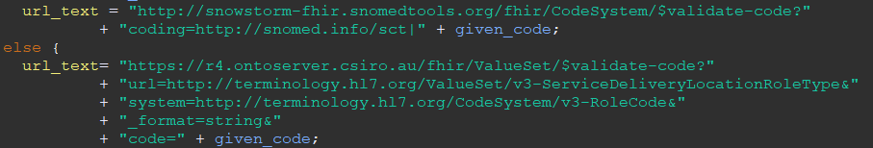
Q1: What would be the benefits?
Standardization and Interoperability: by using a FHIR terminology server, healthcare systems and applications can ensure consistency and interoperability in the way they represent and exchange clinical data.
Consistency/Validation in Data Exchange: a FHIR terminology server allows for the mapping and translation of codes between different systems, ensuring that data can be accurately exchanged and understood across disparate healthcare
Efficient Data Retrieval: instead of maintaining large, local copies of terminology databases, applications can query the server for the latest information, reducing data redundancy and maintenance efforts (Reduced Maintenance Burden);
All in all, for instance, avoids future errors when dealing with data (clinical trial selection, diagnosis, disease’s pattern analysis, decision support systems training, etc.)
Snowstorm→ open source terminology server with special support for SNOMED CT.
Ontoserver → Next-gen FHIR terminology server developed by the Australian e-Health Research Centre, CSIRO.
23

Slide 24
Q2: How could FHIR StructureDefinition resources be used for data validation?
“A definition of a FHIR structure. This resource is used to describe the underlying resources, data types defined in FHIR, and also for describing extensions and constraints on resources and data types”;
Resource of the Conformance category;
Used to define the basic structures of FHIR: data types, resources, extensions, and profiles;
“StructureDefs are the bones/branches, terminology is the meat/leaves/fruit”
Validating means checking for:
Structure
Cardinality
Value Domains
Coding/CodeableConcept bindings
Invariants
Profiles
24

Slide 25
Q2: How could FHIR StructureDefinition resources be used for data validation?
So, StructureDefinition Resource may (and should) be used by validation tools to verify if Resources, datatypes, etc. are built correctly and have accurate values inserted in each field;
So, they can be used for data validation in several ways:
Schema validation: ensure that they conform to the expected structure;
Element presence and its cardinality: ensure that mandatory elements are present and that the number of occurrences for each element is within the specified range;
Data types and value sets: ensure that elements have the correct data type and that their values are within defined value sets;
Profile Conformance;
And others...
25

Slide 26
Q3: Which strategies would you use for auditing and monitoring?
"A FHIR server should keep a complete, tamper-proof log of all API access and other security- and privacy-relevant events“;
“AuditEvent resource suitable to record when a security or privacy relevant event has occurred“ → “subsequent review and detection of intrusion or inappropriate usage”;
All actors - such as applications, processes, and services - involved in an auditable event
Other logs may be used – HTTP logs + server general functionalities logs (which operations fails more time and why, which are the most requested operations, etc.)
26

Slide 27
Q3: Which strategies would you use for auditing and monitoring?
Auditing and monitoring a FHIR server or service are crucial to ensure security, compliance, performance, and the overall integrity of healthcare data;
Strategies:
General logging: including user actions, system operations, security events, and access attempts;
Access control and authentication: track successful and failed login attempts, access to sensitive data, and any changes in user roles or permissions;
Data access monitoring: capture information about the requester, the requested resource, the timestamp, and the outcome of the request;
Performance monitoring: examine response times, resource utilization, errors, …
27

Slide 28
Q4: How would you measure and improve performance for this service?
Response time monitoring: analyze for various operations to identify bottlenecks (by logging this times);
Throughput and concurrent requests: measure capacity to handle concurrent requests (load testing) and the total number of transactions or operations it can process per unit of time;
Error rate and analysis: identify common errors and their frequency (by logging errors);
Database performance metrics: monitor database performance metrics, including query execution times, indexing efficiency, and database throughput;
Cache: monitor the effectiveness of caching mechanisms in reducing database queries and enhancing response times (by measuring times with and without caching).
28

Slide 29
Q4: How would you measure and improve performance for this service?
Caching: implement efficient caching mechanisms to reduce the load on the server (for instance, cache commonly accessed resources or responses);
Scaling: add more servers (horizontal scaling) or increasing server capacity (e.g., CPU, memory – vertical scaling). Also, load balancers to distribute traffic.
Asynchronous Processing: for resource-intensive operations to avoid blocking the server;
General regular optimization: examine server-side code to identify and rectify performance bottlenecks + analyze causes of errors and handle them effectively + optimize database queries and indexing strategies;
29

Slide 30
EXTRA SLIDES

Slide 31
SEQUENTIAL STEPS TAKEN
1. Read document once + a second time more carefully and identify possible doubts, FHIR specification components relevant for the project, tools to learn, among others;
3. Analyze FHIR messaging pardigm information, identifying and comparing such information with the features needed to eb present in the service;
4. Analyze important Resources: MessageDefinition, Encounter, MessageHeader (and Patient);
5. New analysis of the challenge statement;
6. Draw an initial basic schematic of the service and its components;
7. Initial study of REST API designing with Spring Boot (Spring Boot Guides, YouTube);
8. Realization that perhaps it was not the best approach for dealing with the messaging component;
9. Turn to the HAPI FHIR option because the specification mentions a $process-message operation;
10. Read $process-message operation and understand how its requisites may be translated to effective and efficient code programming;
11. Enhance the initial schematic of the service and its components;
12. Implementation question: upload all database information at once initially into the server or get information from the database at each request? (study and decision) (Goal 4.);
13. Implementation question: Maven vs. Gradle;
31

Slide 32
SEQUENTIAL STEPS TAKEN
14. Read FHIR services and FHIR Storage pages of the specification to perceive some guidelines recommended by the specification (Goal 4.);
15. Install MongoDB Compass (GUI) (Goal 4.);
16. Define project’s pom.xml file with all the dependencies;
17. Start solution development with the base restful server (restfulServer.java);
18. (Initial debugging/problems phase dealing with Java versions used in the cmd+IDE+HAPI FHIR compiler) + (problems with the validation module of the HAPI FHIR library – it had to be withdrawn from the server and the important validation was made “by hand”);
19. Messaging part settled (Goal 1);
20. Start with GET requests processing (FHIR REST API’s Read interaction);
21. MongoDBConnectionManager definition – allows an easy and centralized way to access the database for all classes (code quality, reusability and readibility);
22. Advance further and finalize REST part, including versioned resources feature (Goal 2 + 5a.);
23. Implement access control through an authorization service (Spring Authorization Server) (Goal 5.b);
24. Final testing phase;
25. Make use of HAPI FHIR’s functionalities to document the service via the OpenAPI specification (Goal 3);
32

Slide 33
Q: Upload all database information at once at the server start or get information from the database at each request?
Preloading upon initialization
Fetching from database at each request
/implementation_question1
Pros: faster response times, reduced database load
Cons: increased memory usage, stale data
Use case: scenarios where data is relatively static + read-heavy applications + small to moderately sized dataset.
Pros: real-time data, lower memory usage + scalability
Cons: slower response times, database load
Use case: scenarios where data changes frequently, or the dataset is too large for the memory + write-heavy applications + rapidly changing data (other services accessing and changing data)
33

Slide 34
Q: Gradle (“suggested” in the instructions) vs. Maven
Gradle
Maven
/implementation_question2
More powerful;
Suitable for bigger projects.
Preferable in smaller projects;
Ease to migrate to Gradle, if project outgrows.
Experience handling it.
34

Slide 35
Q: Spring Boot (“suggested” in the instructions) vs. Eclipse Jetty
/implementation_question3
Past experience with Eclipse Jetty and its good pairing with the HAPI FHIR library made me choose it.
Even so, I believe that deploying the server with Spring Boot would be rather simple (possibly add the dependency to the pom.xml, also add a SprinBootApplication annotation to the Restful server and few other – if any – steps).
35

